Slide 1
BUGI Western Balkans Urban Agriculture Initiative
Innovative examples of urban food production in [Ljubljana, SLOVENIA]
Špela Železnikar, Rozalija Cvejić, Mateja Slovenc, Ana Slatnar, Andrej Udovč, Marina Pintar
University of Ljubljana, Biotechnical Faculty, Department of Agronomy
Erasmus + BUGI, WP3, 2nd study visit
Ljubljana, 19th-21st June, 2018
Project number: 586304-EPP-1-2017-1-BA-EPPKA2-CBHE-JP “This project has been funded with support from the European Commission. This publication reflects the views only of the author, and the Commission cannot be held responsible for any use which may be made of the information contained therein”

Slide 2
Challenges and solutions
BUGI Western Balkans Urban Agriculture Initiative
Challenges:
limited natural resources
most of the population in Ljubljana does not even know that agriculture is still coexisting within the city
three production areas (a) Ljubljansko polje, (b) Ljubljana marshes in the southwestern part of the municipality (c) reliefly diverse hilly area
Solutions:
urban agriculture nad gardening on public spaces, degraded areas, rooftops..

Slide 3
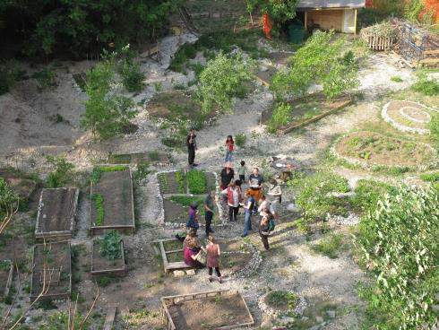
BUGI Western Balkans Urban Agriculture Initiative
Innovative example 1
Beyond the Construction Site
…is a civil initiative exploring the capacity of unused land in the city of Ljubljana….
AIM:
Inclusion of local residents in govern-ing the city green space.
INNOVATIVE HIGHLIGHTS:
The crucial role of facilitators in assessing citizens’ needs and engaging them in the govern-ance process.

Slide 4
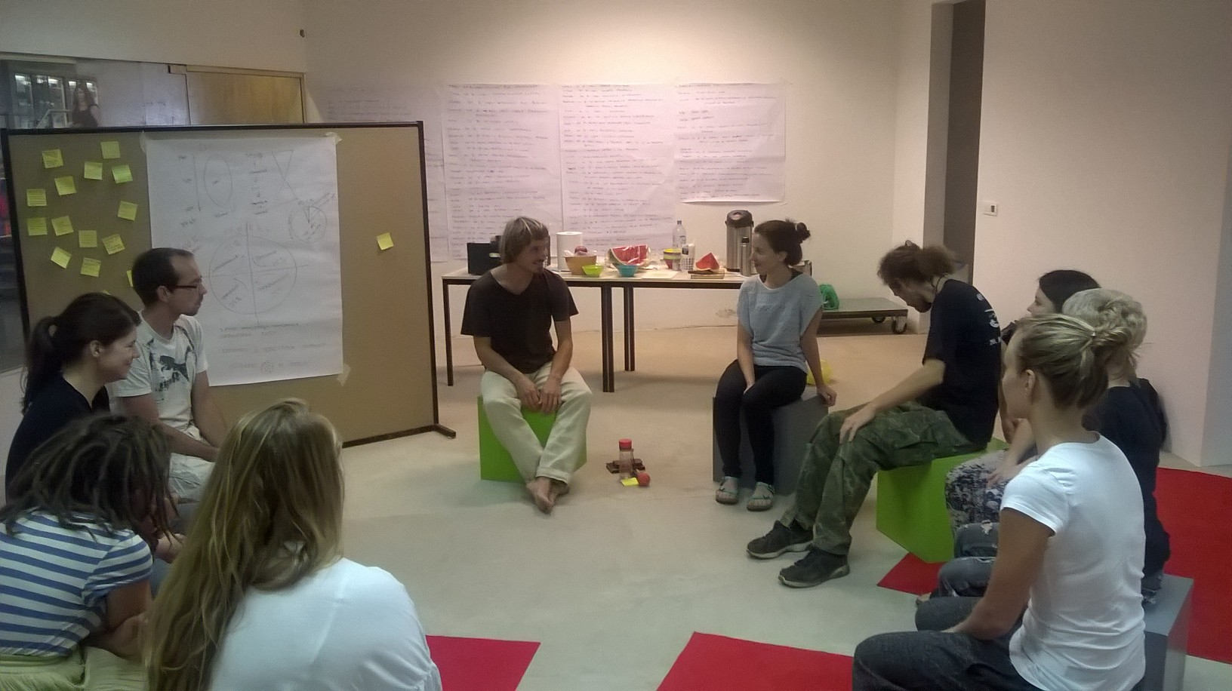
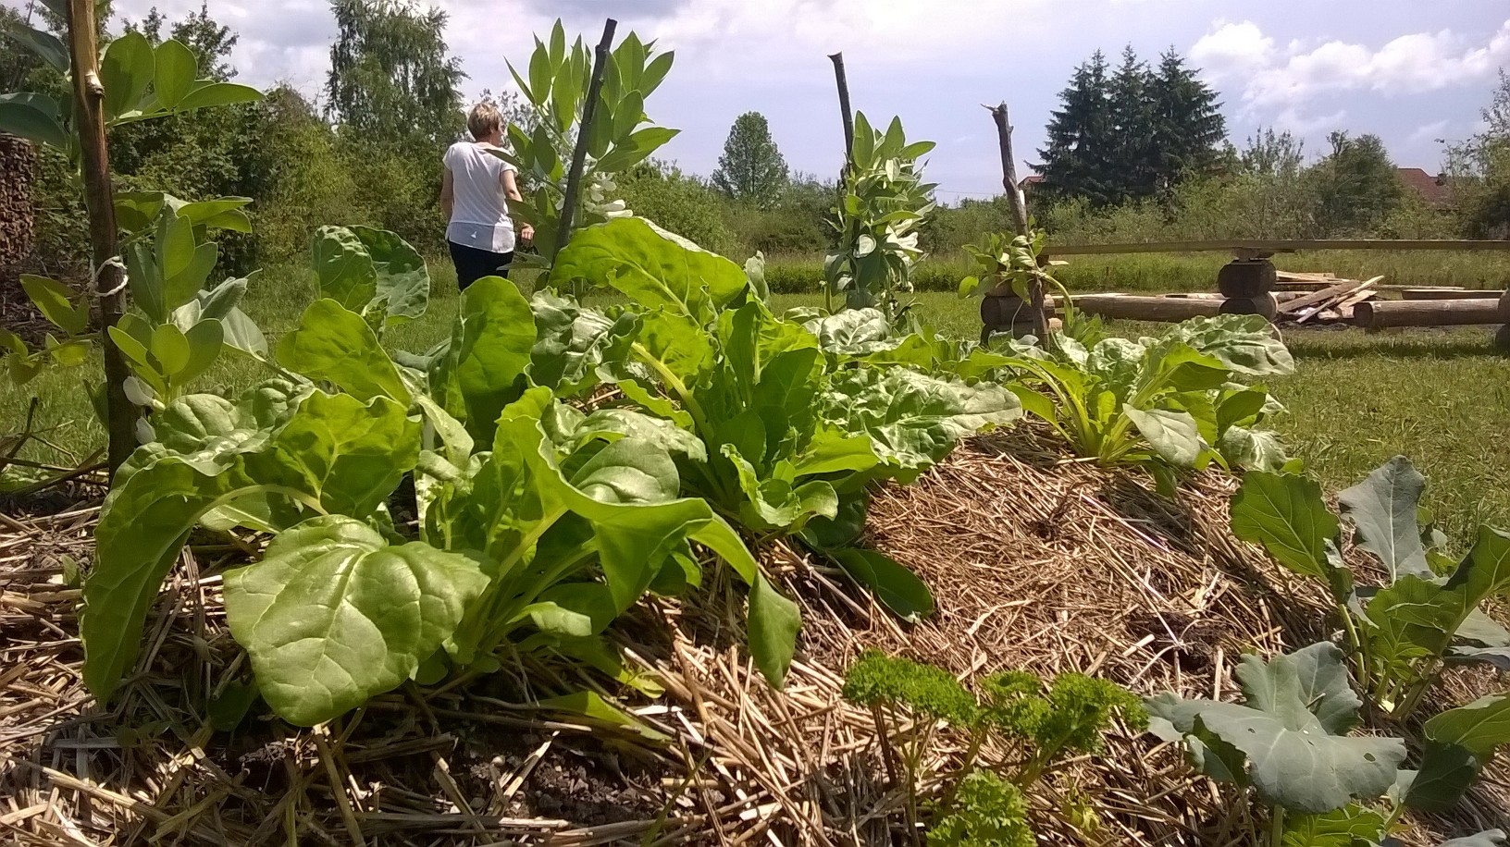
Innovative example 2
BUGI Western Balkans Urban Agriculture Initiative
Livada LAB
…socially inclusive planning, delivery and management of urban green space WITH YOUTH…
GOAL:
To establish a project-based learning model involving young people in the process of participatory planning and governance of urban green areas - a method to improve ESS of urban green areas as well as the socio-economic independence of the involved young people.

Slide 5
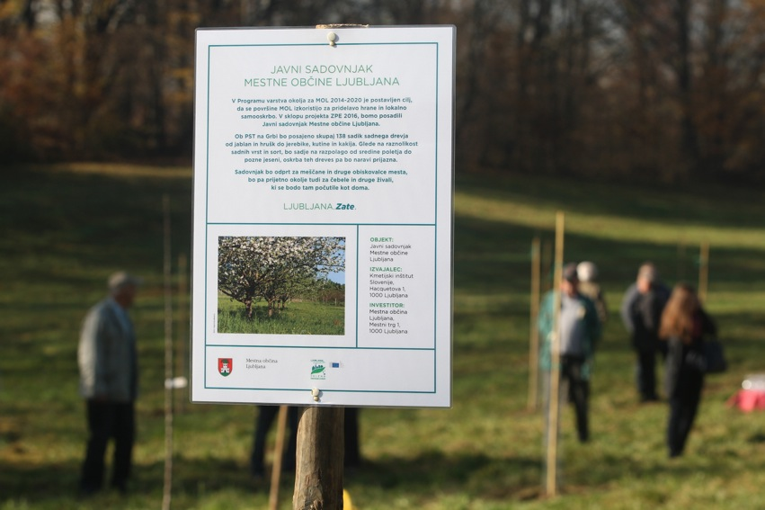
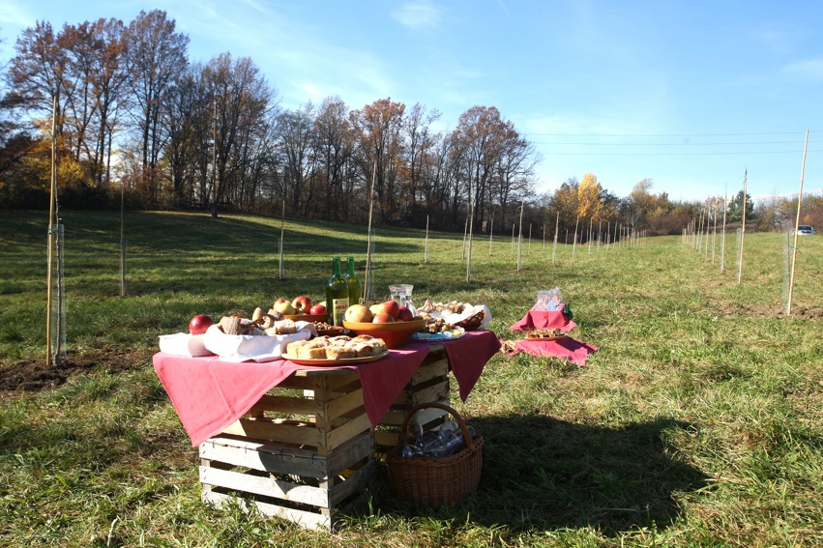
Innovative example 3
BUGI Western Balkans Urban Agriculture Initiative
Urban / city orchad
5 locations planted with 494 fruit trees.
open to citizens and other visitors to the city, while at the same time it provides a pleasant environment for bees and other animals. In the orchard, space is also intended for education and exchange of experiences and leisure activities

Slide 6
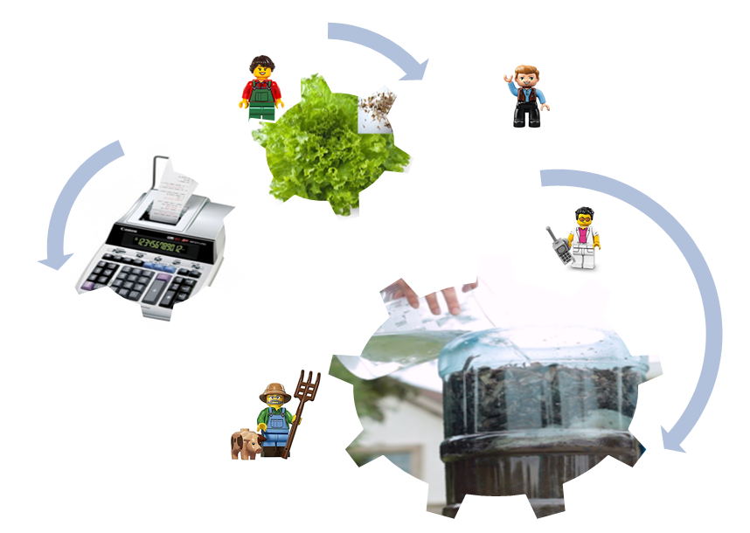
Team presentation Ljubljana, SLOVENIA
BUGI Western Balkans Urban Agriculture Initiative
How does the professional background of your team contribute to urban agriculture?

Slide 7
References
BUGI Western Balkans Urban Agriculture Initiative
http://geo.ff.uni-lj.si/sites/geo.ff.uni-lj.si/files/Dokumenti/Publikacije/geograff_2.pdf
https://onkrajgradbisca.wordpress.com/
https://www.facebook.com/LivadaLAB/
http://ljubljanski.projekti.si/mestni-sadovnjak.aspx
https://greensurge.eu/working-packages/wp6/files/Innovative_Governance_of_Urban_Green_Spaces_-_Deliverable_6.2.pdf

