Slide 1
Programiranje u agribiznisu
sedmica I/XV
doc. dr. Mirza Uzunović
Poljoprivredno-prehrambeni fakultet Univerziteta u Sarajevu
Sarajevo, 2019
Project number: 586304-EPP-1-2017-1-BA-EPPKA2-CBHE-JP “This project has been funded with support from the European Commission. This publication reflects the views only of the author, and the Commission cannot be held responsible for any use which may be made of the information contained therein”

Slide 2
Programiranje u agribiznisu

Slide 3
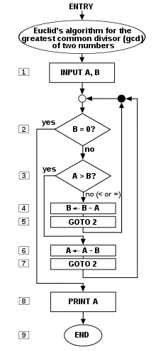
Programiranje u agribiznisu – ishodi učenja
Cilj predmeta je unaprijediti razumijevanje mogućnosti tehnoloških rješenja prilikom instalacije malih proizvodnih sistema u urbanoj poljoprivredi i analizi velikog broja podataka prikupljenih sa tržišta ili senzorskih podataka. Upoznavanje polaznika sa programskim jezikom Python i algoritamskog načina razmišljanja pri rješavanju problema koje nose mali proizvodni sistemi, mogućnostima automatizacije dijela (ili ukupnog) procesa i korištenja informacija sa tržišta i unapređenja operativnih performansi proizvodnje i distribucije u urbanoj poljoprivredi.

Slide 4
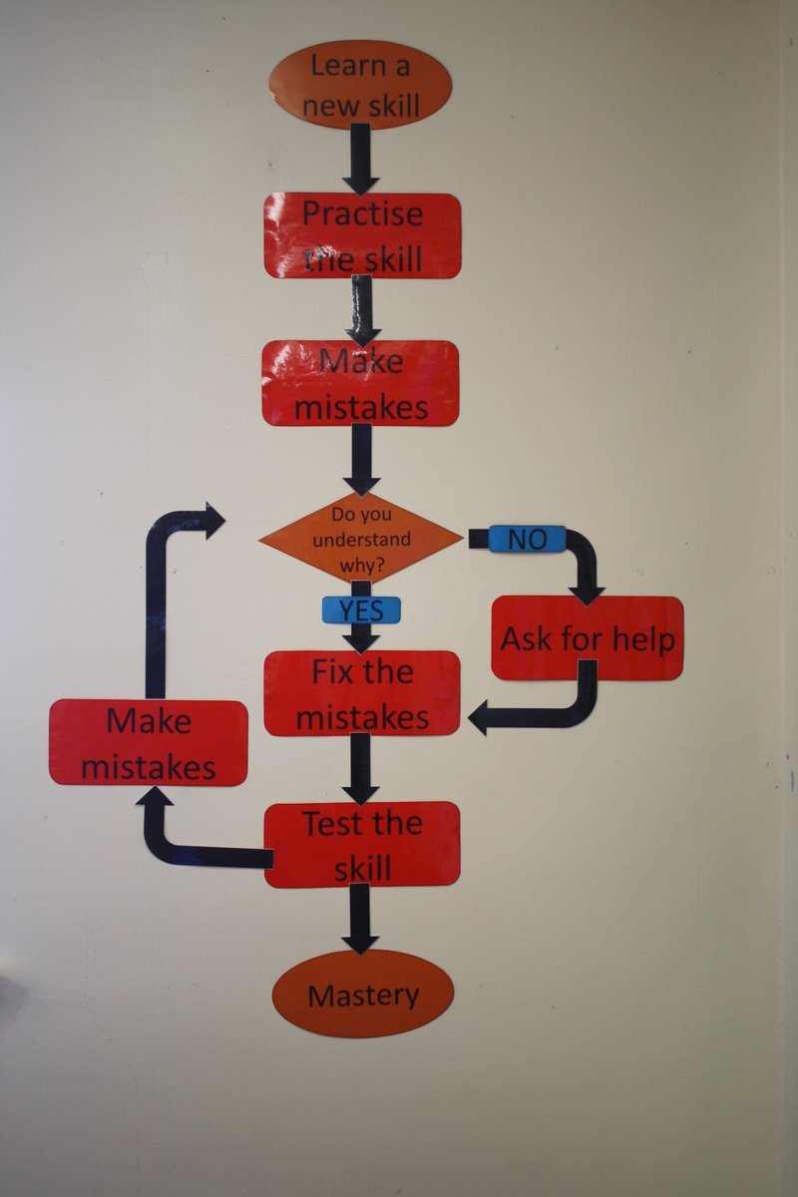
Programiranje u agribiznisu

Slide 5
Programiranje u agribiznisu

Slide 6
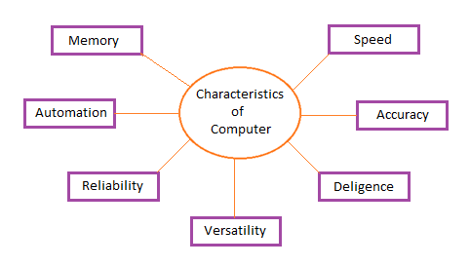
Programski jezik
Pojam jezika
Programski jezik
Rješavanje problema
Pojednostavljenje
Automatizacija

Slide 7
Programiranje u agribiznisu
sedmica II/XV
doc. dr. Mirza Uzunović
Poljoprivredno-prehrambeni fakultet Univerziteta u Sarajevu
Sarajevo, 2019
Project number: 586304-EPP-1-2017-1-BA-EPPKA2-CBHE-JP “This project has been funded with support from the European Commission. This publication reflects the views only of the author, and the Commission cannot be held responsible for any use which may be made of the information contained therein”

Slide 8
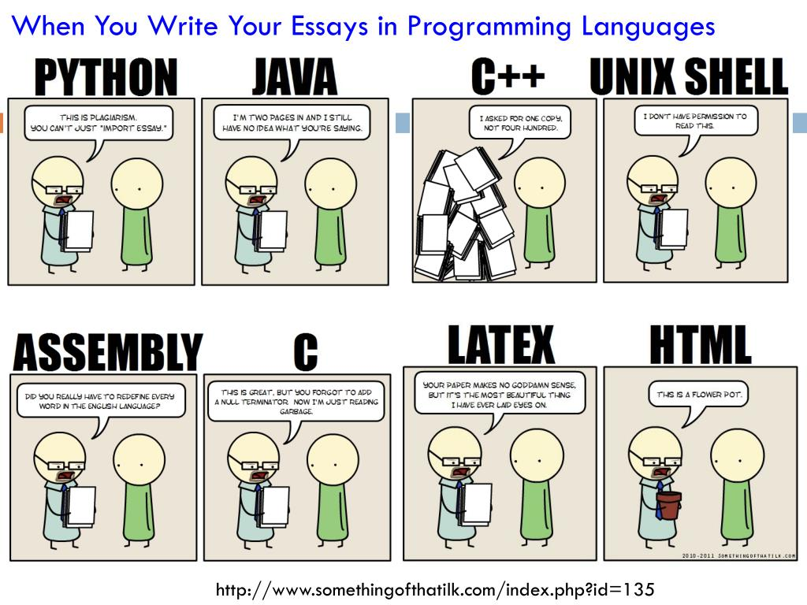
Programski jezik python

Slide 9
Programski jezik python

Slide 10
Programski jezik python

Slide 11
Programski jezik python
https://python.org/

Slide 12
Programski jezik python - IDE
https://code.visualstudio.com/

Slide 13
Programiranje u agribiznisu
sedmica III/XV
doc. dr. Mirza Uzunović
Poljoprivredno-prehrambeni fakultet Univerziteta u Sarajevu
Sarajevo, 2019
Project number: 586304-EPP-1-2017-1-BA-EPPKA2-CBHE-JP “This project has been funded with support from the European Commission. This publication reflects the views only of the author, and the Commission cannot be held responsible for any use which may be made of the information contained therein”

Slide 14
Algoritamsko rješavanje problema

Slide 15
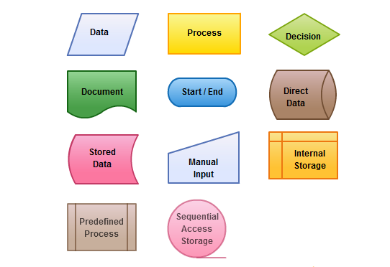
Algoritamsko rješavanje problema

Slide 16
Algoritamsko rješavanje problema
Koristeći se simbolima i algoritamskim načinom razmišljanja, riješite sljedeći problem?

Slide 17
Programiranje u agribiznisu
sedmica IV/XV
doc. dr. Mirza Uzunović
Poljoprivredno-prehrambeni fakultet Univerziteta u Sarajevu
Sarajevo, 2019
Project number: 586304-EPP-1-2017-1-BA-EPPKA2-CBHE-JP “This project has been funded with support from the European Commission. This publication reflects the views only of the author, and the Commission cannot be held responsible for any use which may be made of the information contained therein”

Slide 18
Tipovi podataka python

Slide 19
Tipovi podataka python

Slide 20
Flow Control

Slide 21
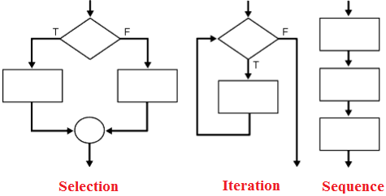
Flow Control

Slide 22
Programiranje u agribiznisu
sedmica V/XV
doc. dr. Mirza Uzunović
Poljoprivredno-prehrambeni fakultet Univerziteta u Sarajevu
Sarajevo, 2019
Project number: 586304-EPP-1-2017-1-BA-EPPKA2-CBHE-JP “This project has been funded with support from the European Commission. This publication reflects the views only of the author, and the Commission cannot be held responsible for any use which may be made of the information contained therein”

Slide 23
Metodi i funkcije

Slide 24
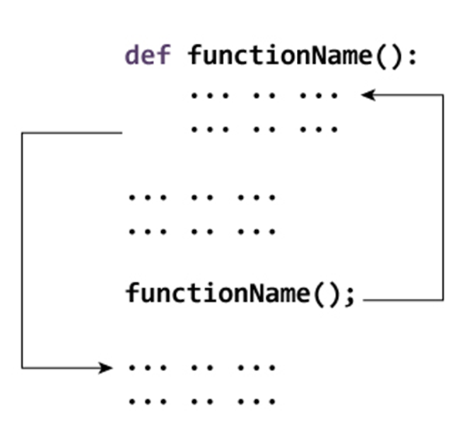
Metodi i funkcije

Slide 25
Metodi i funkcije

Slide 26
Metodi i funkcije

Slide 27
Programiranje u agribiznisu
sedmica VI/XV
doc. dr. Mirza Uzunović
Poljoprivredno-prehrambeni fakultet Univerziteta u Sarajevu
Sarajevo, 2019
Project number: 586304-EPP-1-2017-1-BA-EPPKA2-CBHE-JP “This project has been funded with support from the European Commission. This publication reflects the views only of the author, and the Commission cannot be held responsible for any use which may be made of the information contained therein”

Slide 28
Upravljanje iznimkama

Slide 29
Upravljanje iznimkama

Slide 30
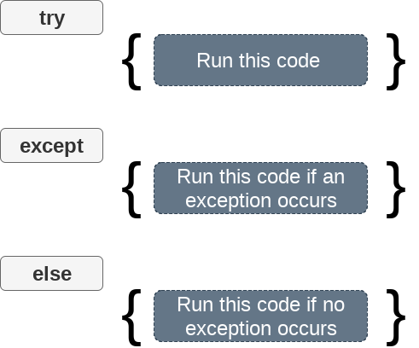
Upravljanje iznimkama

Slide 31
Programiranje u agribiznisu
sedmica VII-VIII/XV
doc. dr. Mirza Uzunović
Poljoprivredno-prehrambeni fakultet Univerziteta u Sarajevu
Sarajevo, 2019
Project number: 586304-EPP-1-2017-1-BA-EPPKA2-CBHE-JP “This project has been funded with support from the European Commission. This publication reflects the views only of the author, and the Commission cannot be held responsible for any use which may be made of the information contained therein”

Slide 32
OOP

Slide 33
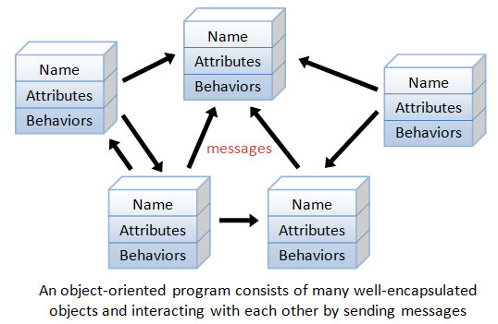
OOP

Slide 34
OOP

Slide 35
OOP

Slide 36
OOP

Slide 37
OOP

Slide 38
OOP

Slide 39
Programiranje u agribiznisu
sedmica IX-X/XV
doc. dr. Mirza Uzunović
Poljoprivredno-prehrambeni fakultet Univerziteta u Sarajevu
Sarajevo, 2019
Project number: 586304-EPP-1-2017-1-BA-EPPKA2-CBHE-JP “This project has been funded with support from the European Commission. This publication reflects the views only of the author, and the Commission cannot be held responsible for any use which may be made of the information contained therein”

Slide 40
Operacije s datotekama
JSON
XML
CSV

Slide 41
Operacije s datotekama

Slide 42
Operacije s datotekama

Slide 43
Operacije s datotekama

Slide 44
Operacije s datotekama

Slide 45
Operacije s datotekama
open() function to open a file.
Example: open(filename, mode='r')
Reading from files: read(), readline() and readlines().
Writing to Files: write()
Adding to Files: append()
Closing the Files: close().

Slide 46
Operacije s datotekama

Slide 47
Operacije s datotekama

Slide 48
Operacije s datotekama

Slide 49
Programiranje u agribiznisu
sedmica XI-XII-XIII/XV
doc. dr. Mirza Uzunović
Poljoprivredno-prehrambeni fakultet Univerziteta u Sarajevu
Sarajevo, 2019
Project number: 586304-EPP-1-2017-1-BA-EPPKA2-CBHE-JP “This project has been funded with support from the European Commission. This publication reflects the views only of the author, and the Commission cannot be held responsible for any use which may be made of the information contained therein”

Slide 50
Analiza i manipulacija podacima
https://matplotlib.org/
https://numpy.org/
https://pandas.pydata.org/

Slide 51
Analiza i manipulacija podacima

Slide 52
Analiza i manipulacija podacima

Slide 53
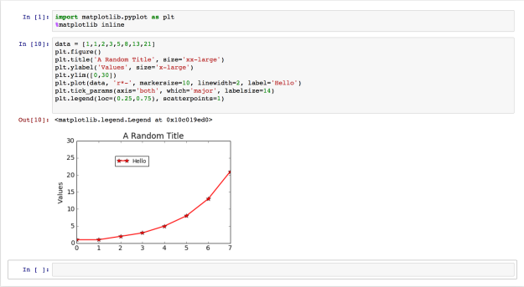
Analiza i manipulacija podacima

Slide 54
Programiranje u agribiznisu
sedmica XIV-XV/XV
doc. dr. Mirza Uzunović
Poljoprivredno-prehrambeni fakultet Univerziteta u Sarajevu
Sarajevo, 2019
Project number: 586304-EPP-1-2017-1-BA-EPPKA2-CBHE-JP “This project has been funded with support from the European Commission. This publication reflects the views only of the author, and the Commission cannot be held responsible for any use which may be made of the information contained therein”

Slide 55
Raspberry Pi Development Platform

Slide 56
Raspberry Pi Development Platform

Slide 57
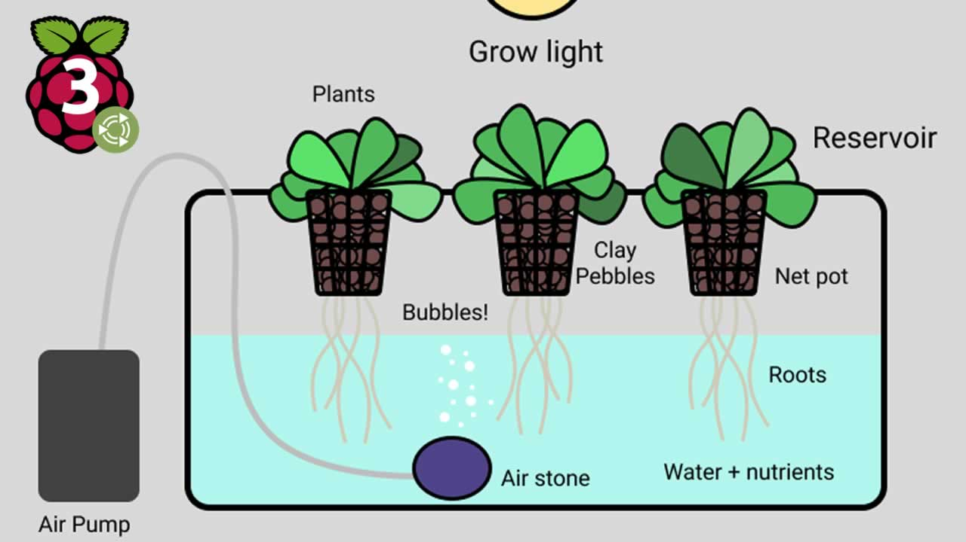
Raspberry Pi Development Platform

Slide 58
Raspberry Pi Development Platform

Slide 59
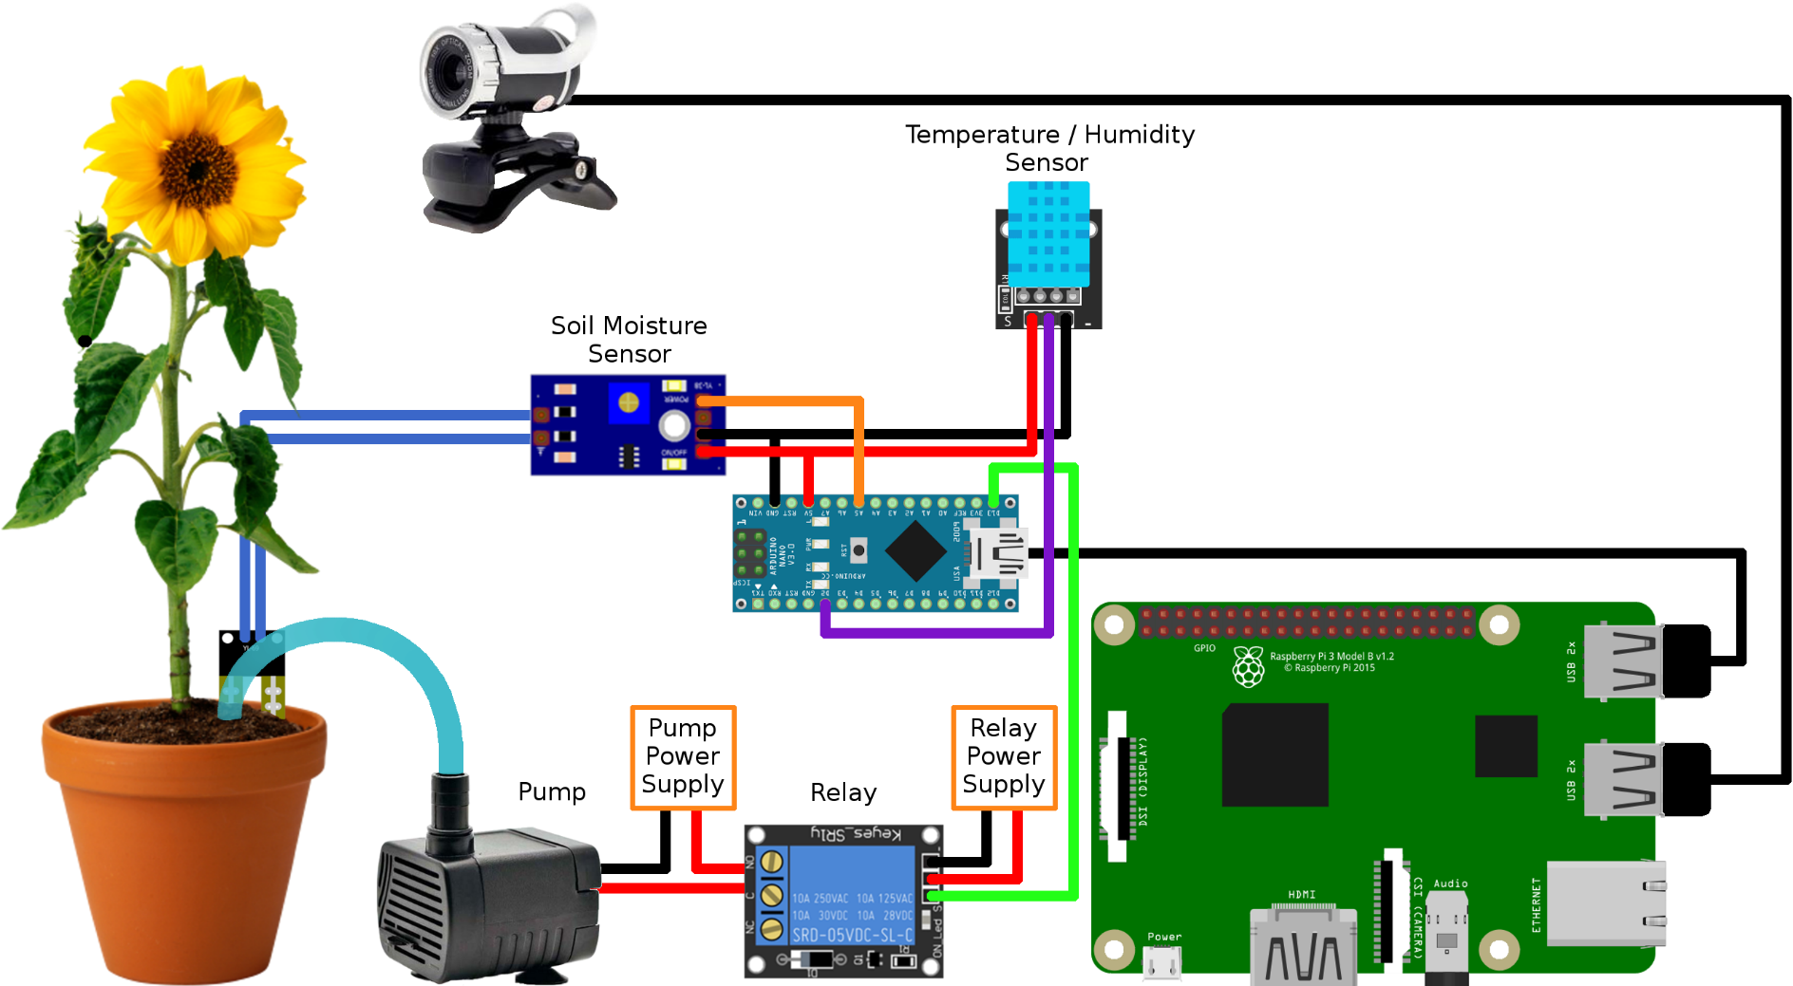
Raspberry Pi Development Platform

Slide 60
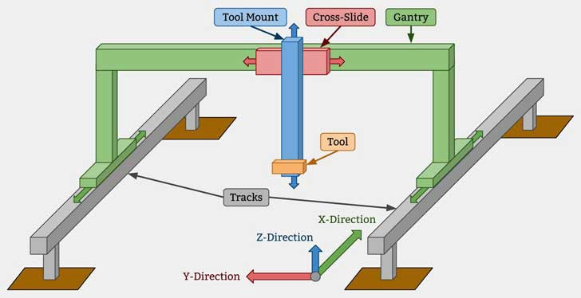
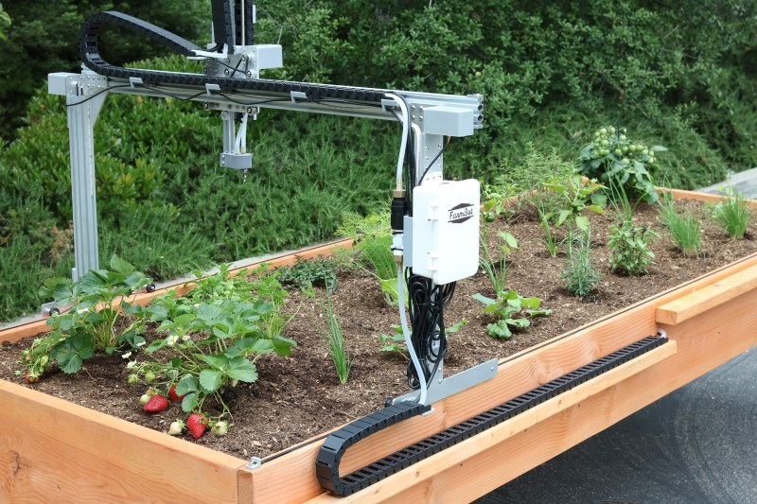
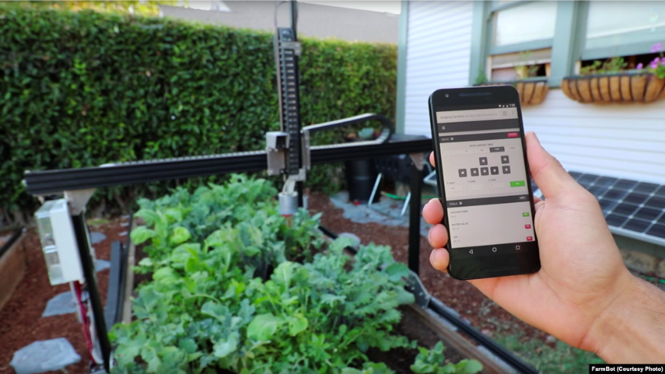
Raspberry Pi Development Platform

Slide 61
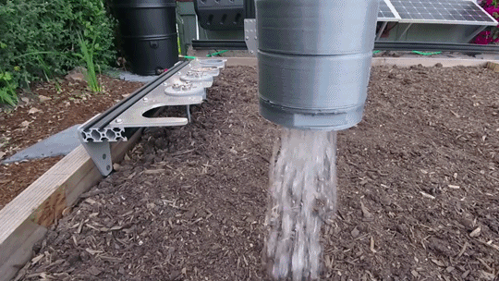
Raspberry Pi Development Platform

Slide 62
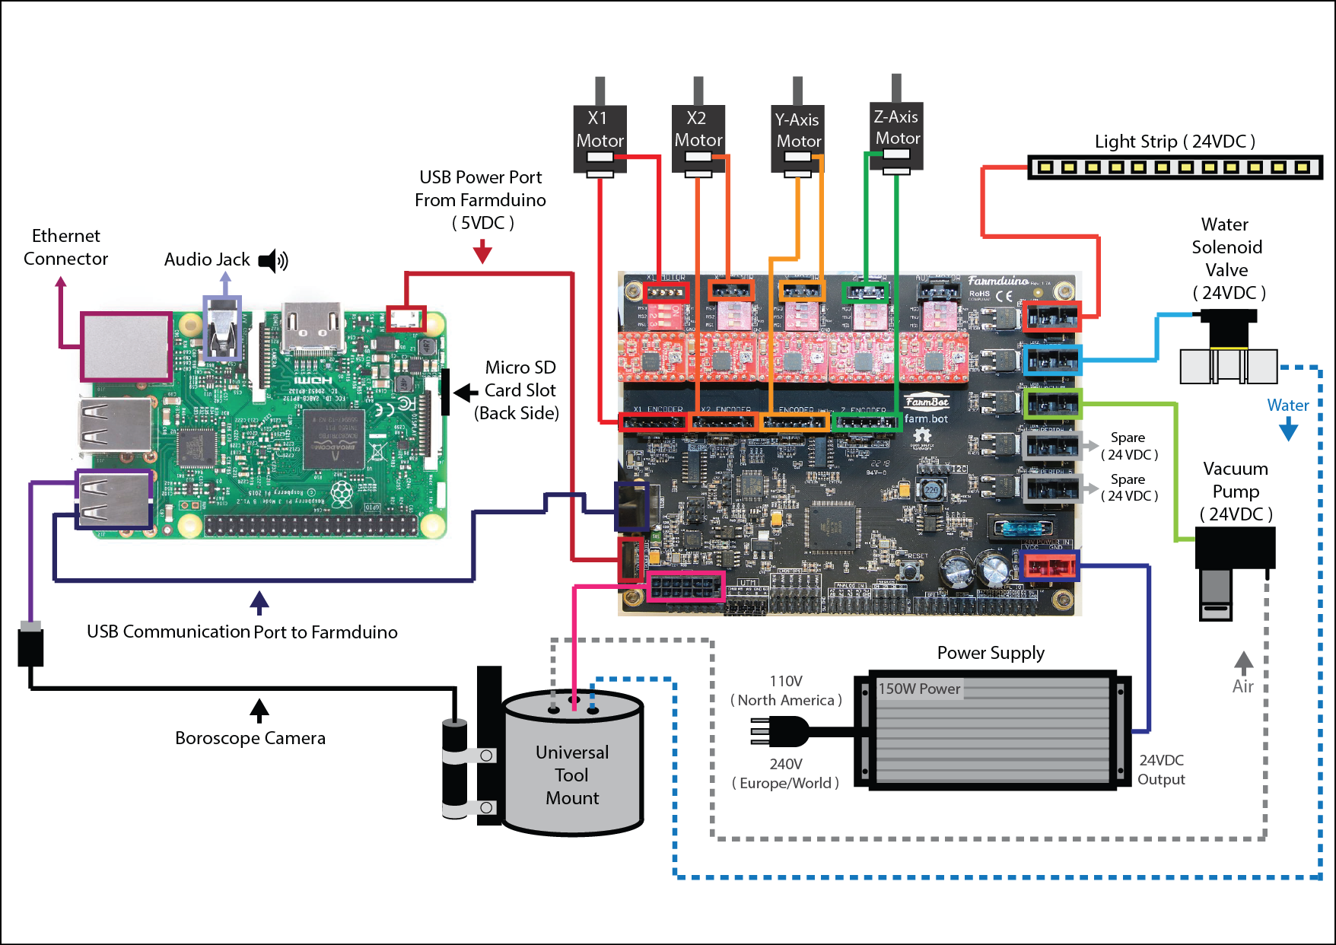
Raspberry Pi Development Platform

Slide 63
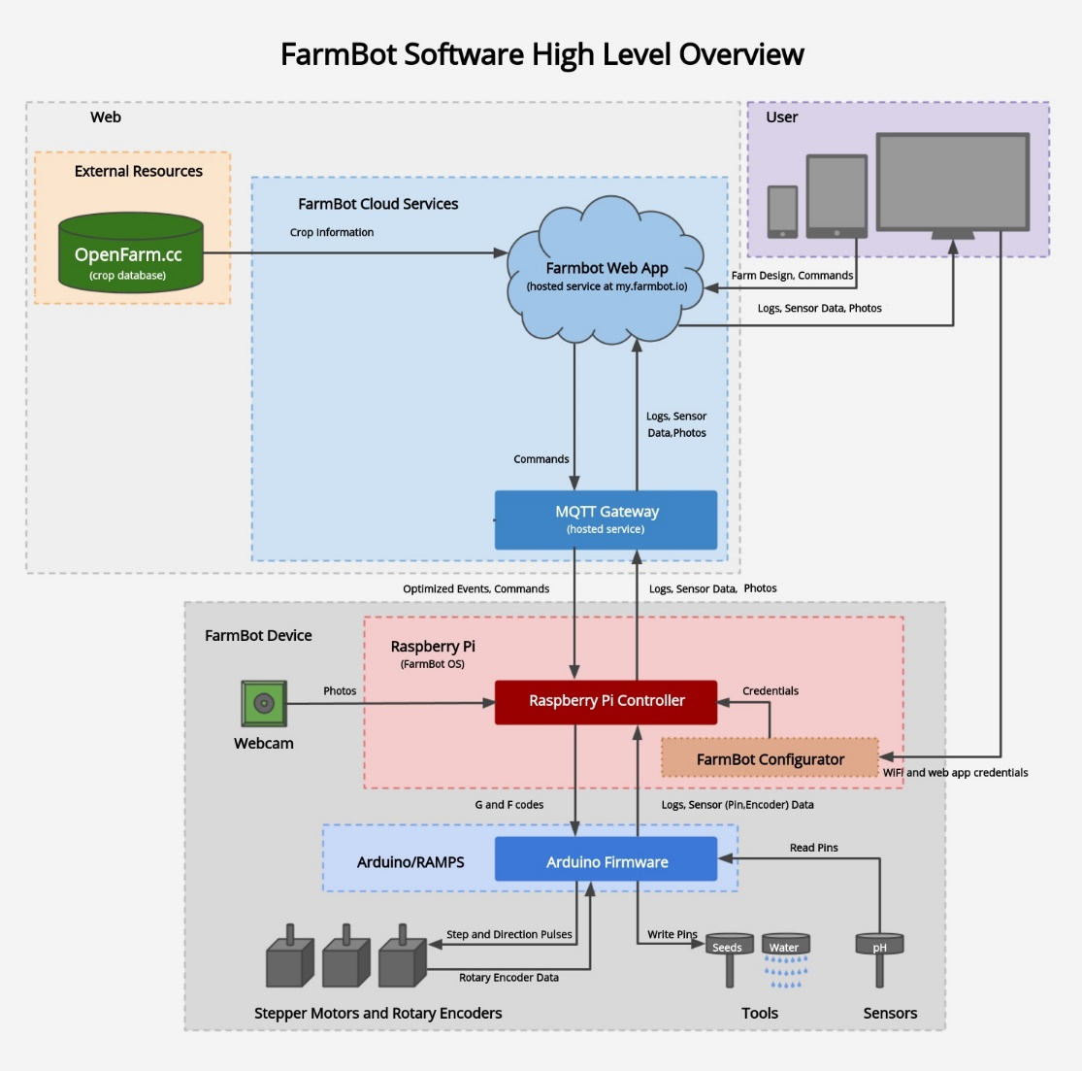
Raspberry Pi Development Platform

